Slide 2
DIGITAL IMAGE PROCESSING PRESENTATION
Instructor: PhD. Tran Thi Thanh Hai PhD. Le Thi Lan

Slide 3

IMAGE DEBLURRING
NGUYEN QUANG ANH - 20213564

Slide 4
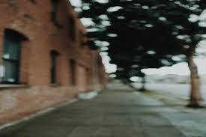
WHAT IS BLUR IN IMAGE
Image blur is an unfavorable loss of bandwidth that reduces image quality and is difficult to avoid.
Blur is produced by both atmospheric instability and improper camera settings. Noise alters the recorded image in addition to blur effects.

Slide 5
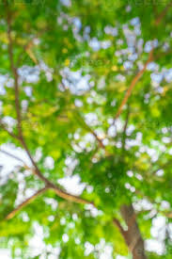

UNNECESSITY OF BLUR
The capability to extract meaningful information from blurry images holds immense importance for diverse applications.
Blur in computer vision refers to the loss of sharpness or clarity in images or videos. It can occur due to different factors.

Slide 6
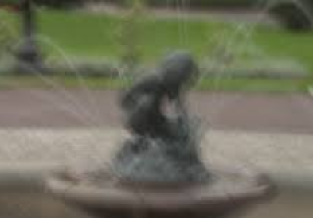
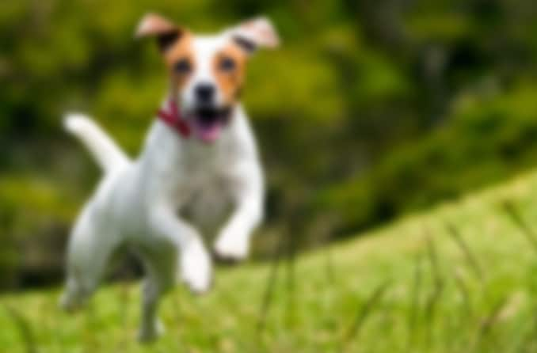
WHAT IMAGE DEBLURRING CAN DO
Image deblurring is a sort of image restoration in which distortions are removed to restore clear images. One sort of distortion is blurring artefacts.
Deblurring is the process of recovering a clear picture from a blurred input. Because it is inherently an inverse problem, there is no one unique solution; it is thus an ill-posed problem.

Slide 7


OUR METHOD
Image Loading
GMM Segmentation
Optimization Setup
IRLS Optimization
Final Visualization

Slide 8
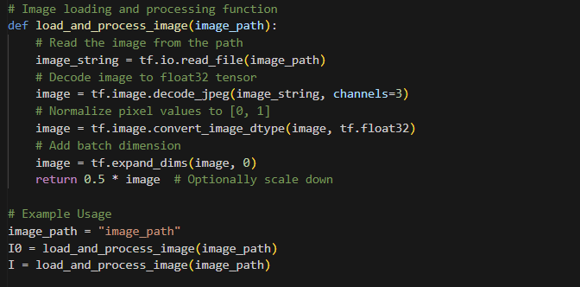
IMAGE LOADING
This section is responsible for loading and initial processing of the image.

Slide 9
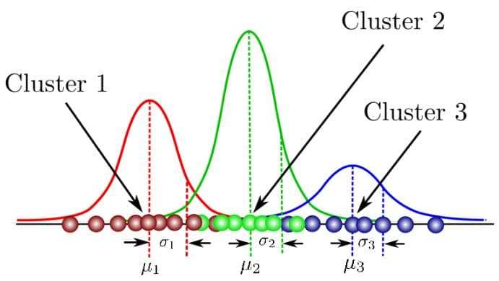
GAUSSIAN MIXTURE MODEL (GMM)
Gaussian Mixture is a function that includes multiple Gaussians equal to the total number of clusters formed. Each Gaussian in the mixture carries some parameters which are:
- A mean, that defines the center.
- A covariance, that defines the width.
- A probability.

Slide 10
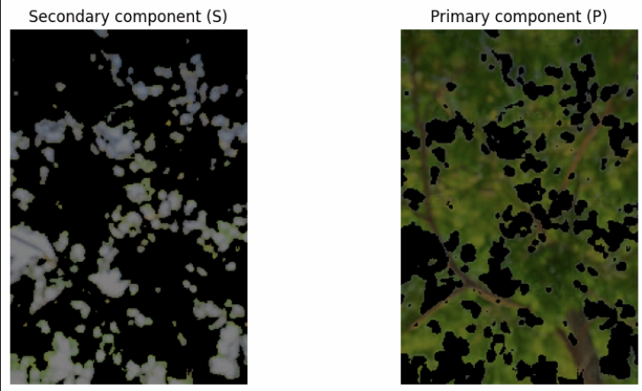
EM ALGORITHM AND TWO-COLOR GMM

Slide 11
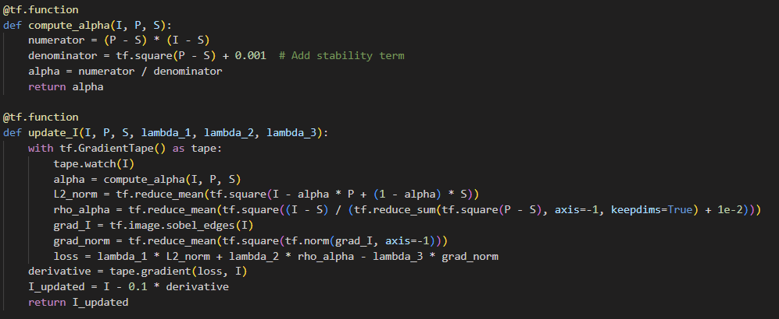
OPTIMIZATION SETUP
This section sets up the necessary components for the optimization process, including initialization and defining regularization parameters.

Slide 12
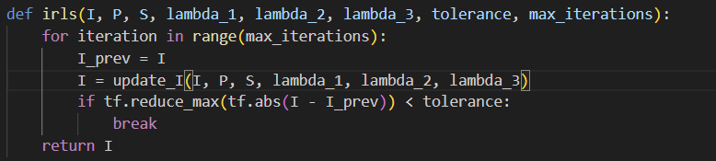
IRLS OPTIMIZATION
The Iteratively Reweighted Least Squares (IRLS) optimization is then performed. This step iteratively updates the image based on the optimization criteria set in the previous step.

Slide 13
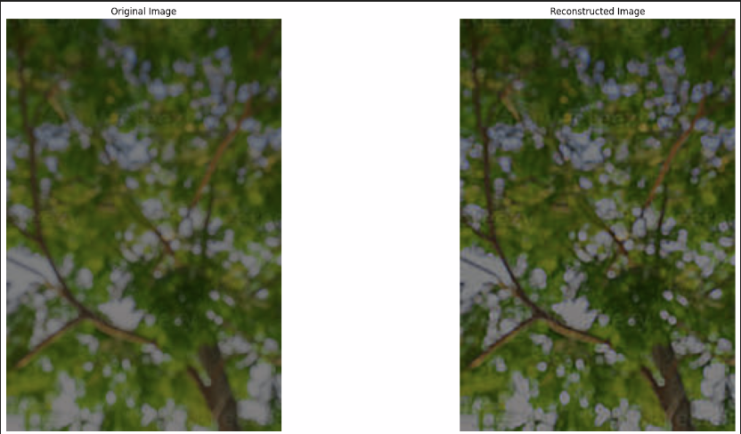
FINAL VISUALIZATION
Finally, the optimized image is visualized alongside the original image for comparison.

Slide 14
THANK YOU !

